Slide 1

Trash Pick-Up Simulator
A Post-Mortem Presentation

Slide 2
Design Debrief

Slide 3

Achieving our Design Objectives:
Design Objective: Environmental proactivity: to spur environmental awareness of the harmful effects of garbage left lying around. This was not meant to encourage the player to “save the world” so much as it was meant to “nudge” the player to pick up any trash they see in real life (like a small invasive memory of the game pushing them to throw things away).
How we Achieved our Design Objective:
A rapidly changing environment that gets “uglier” over time
Pleasant at first, cluttered as time goes on
Foreboding “instability bar” that constantly creeps up toward the max
Notes:
(Lucas)

Slide 4

Intended Experience:
Frantic stress due to trying to keep up with trash spawns
Relief from the successful “scoring” of throwing trash into the bin (missing wastes time)
Pride from a completed trash run
Frustration from missing shots/wasting time
Desire to pick up trash
Desire to not litter
Notes:
(Devun)

Slide 5
Issues
Notes:
Unofficial Issue 6: People are struggling with game and are getting skill diffed.

Slide 6
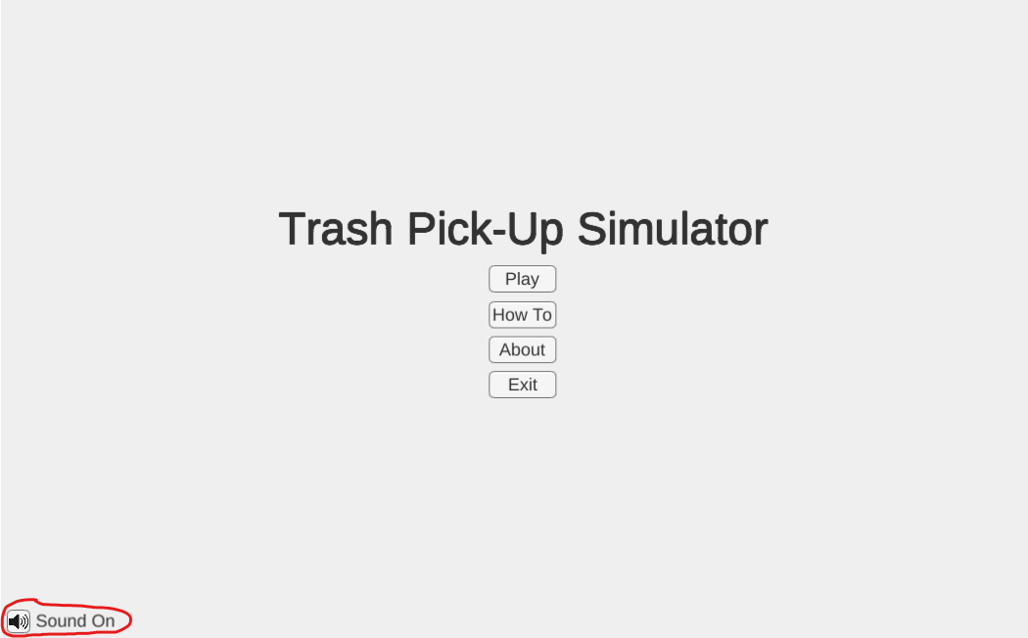
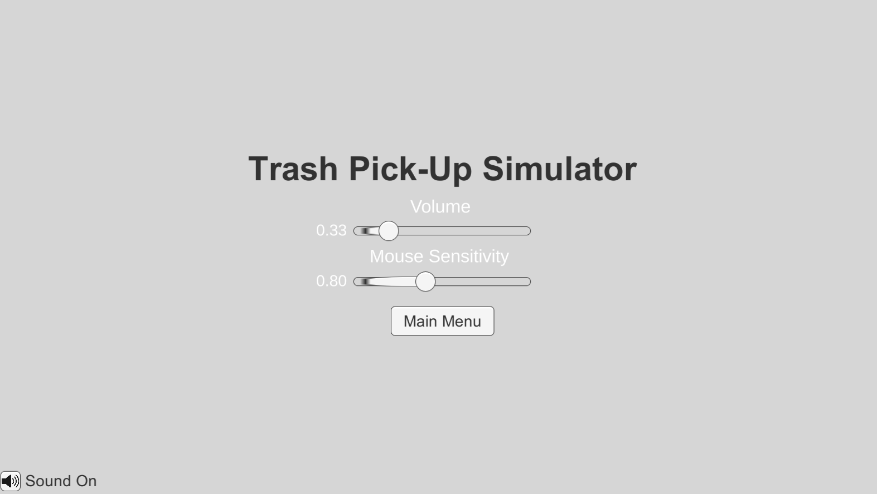
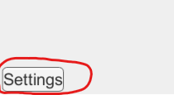

Issue 1: Input Lag
Before:
After:
Priority: 3
Description: Some players had some input lag and it was hard to control mouse sensitivity
Evidence: Players stated this issue out loud and the issue was visible while watching player engage in the game
Action Items: Add a mouse sensitivity slider

Slide 7
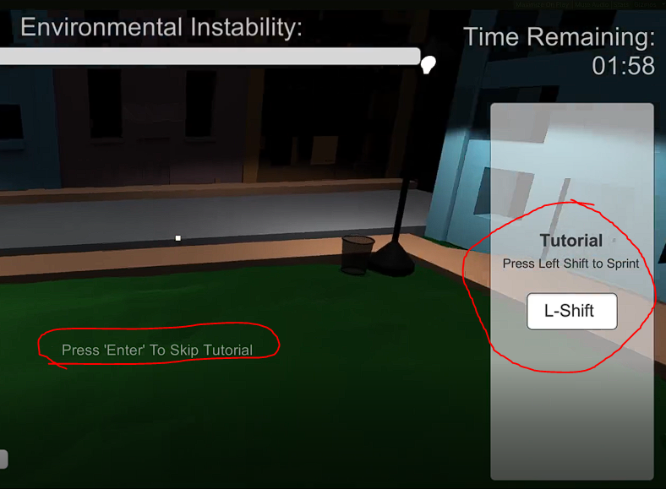

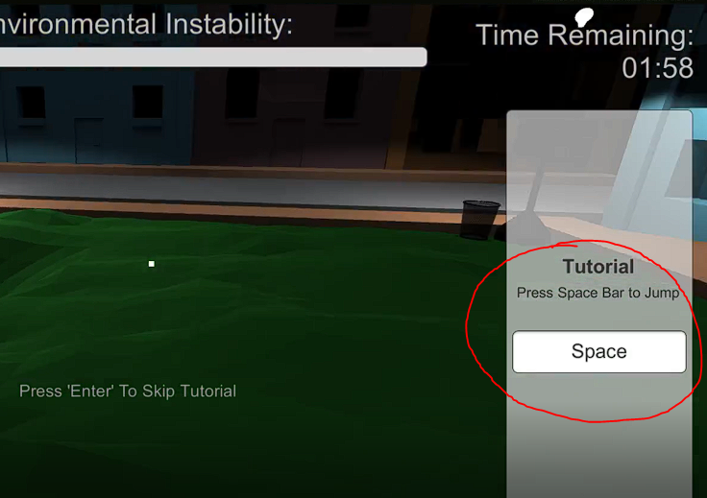
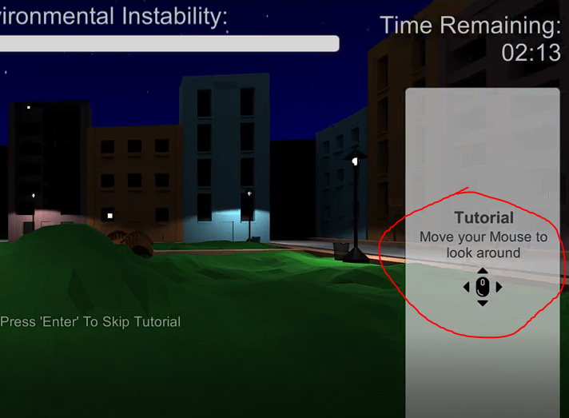
Issue 2: Buggy Tutorial
Before:
After:
Priority: 2
Description Tutorial was missing some controls and repeated after every game
Evidence Tutorial restarted once the level restarted
Action Items: Created a new skippable tutorial scene
Notes:
(Devun)

Slide 8
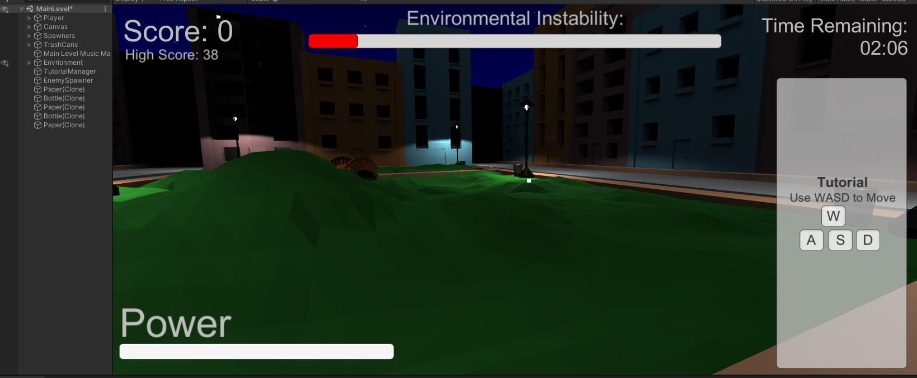
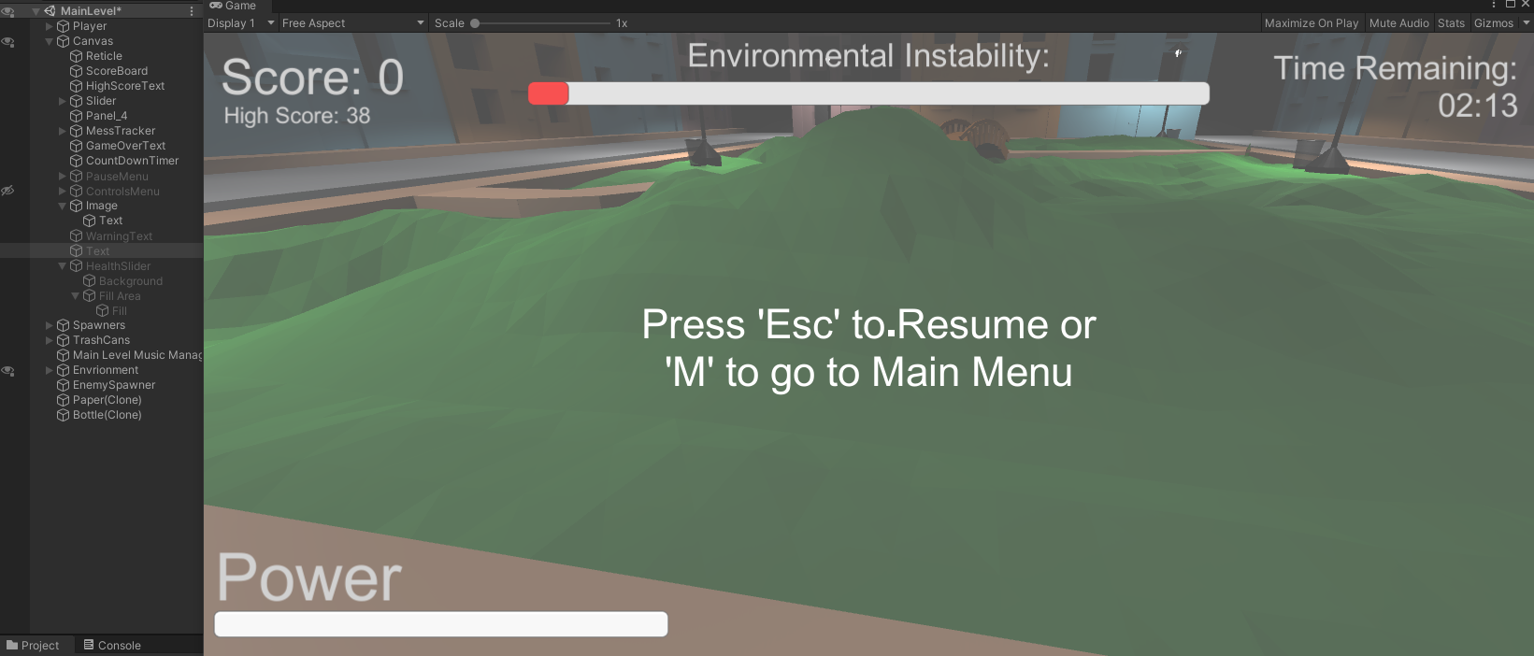
Issue 3: Can’t Pause The Game
Before:
After:
Priority: 2
Description: The game can not be paused.
Evidence: Player asked if the game could be paused and it could not be
Action Items: Add pause menu
Escape now pulls up options and freezes time
Nothing happened upon pressing escape
Notes:
(John)

Slide 9
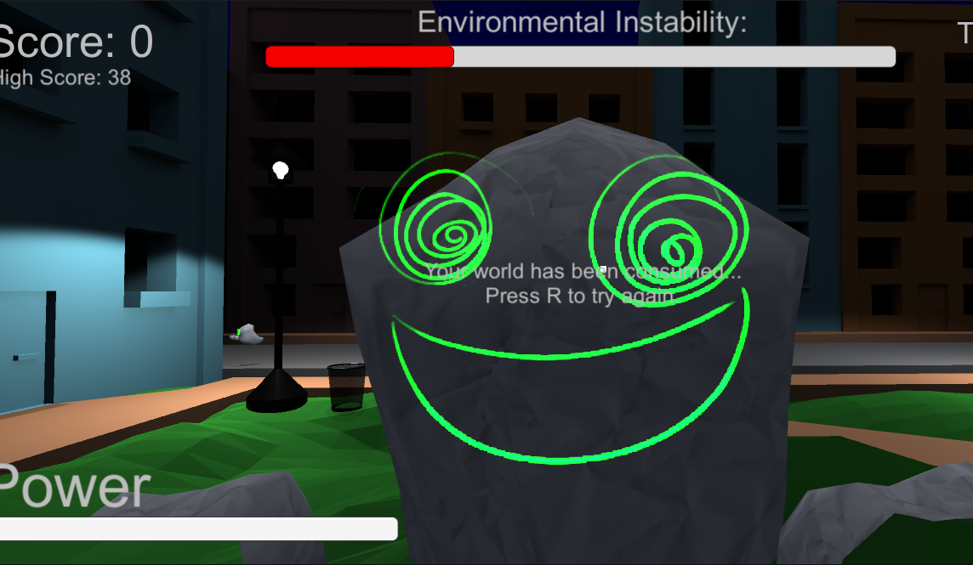
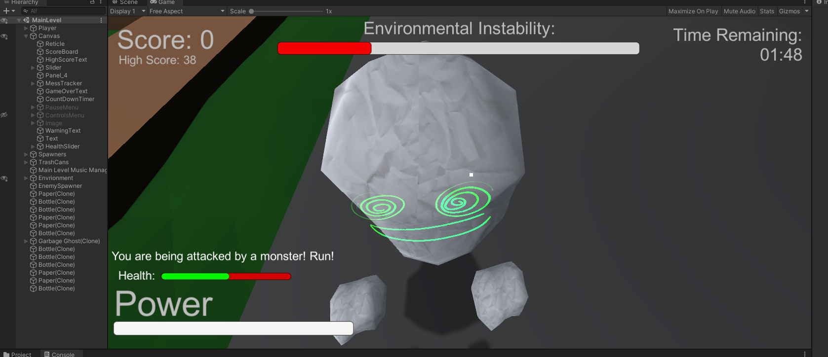
Issue 3.5: Difficulty Balancing
Before:
After:
Priority: 2
Description: The game was a little difficult because of the silent, insta-kill “ninja” monsters
Evidence: Professor mentioned that the monsters frequently snuck up on the player
Action Items: Add health bar to tick down so the player can be made aware that they are being attacked
Implemented health system with sufficient warning for possible evasion
Trash ghosts resulted in instant death, hard to predict, “jumpscare”
Notes:
(John)

Slide 10
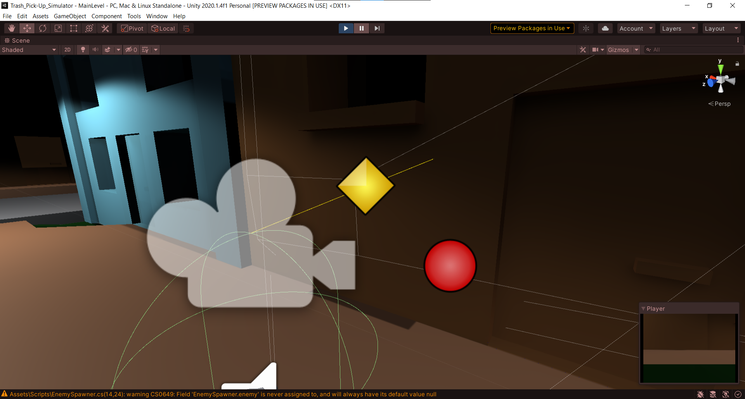
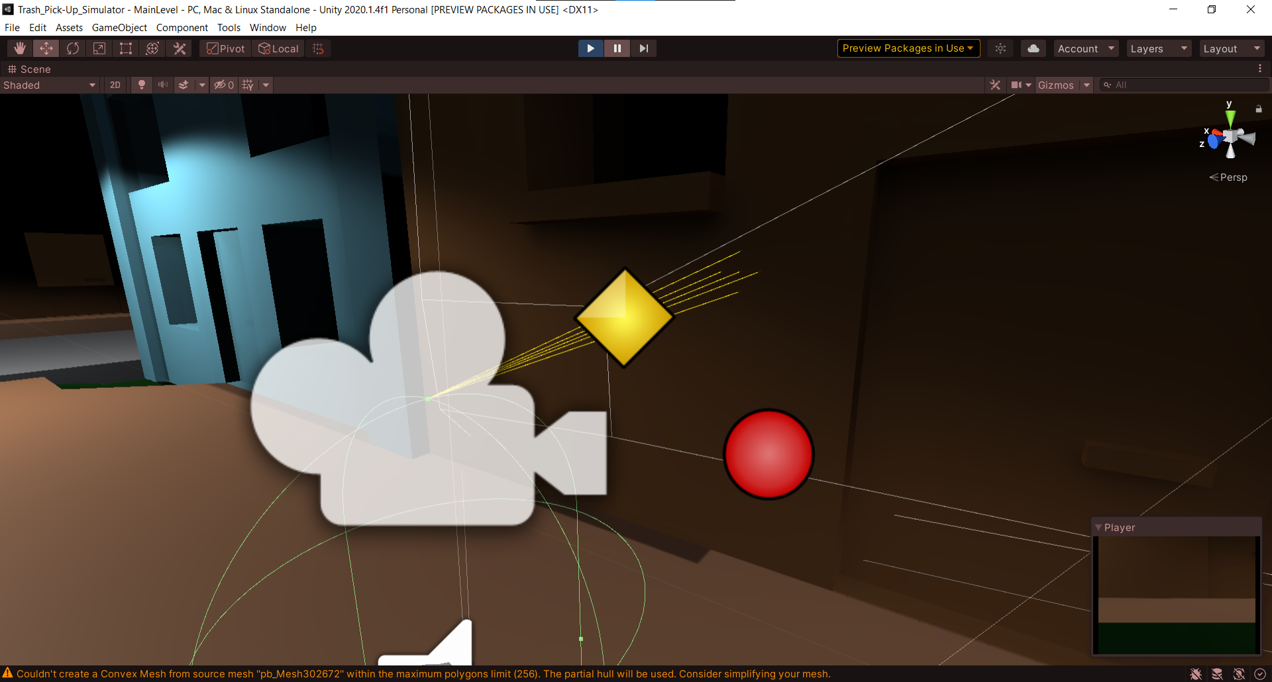
Issue 4: Hard to Pick Up Objects
Before:
After:
Priority: 1
Description: Objects are difficult to pick up; requiring the player to look directly at an object and be close enough to pickup.
Evidence: Players vocally complained that they were unable to pick up objects smoothly
Action Items: Expand pickup range and use a cone instead of a direct raycast

Slide 11
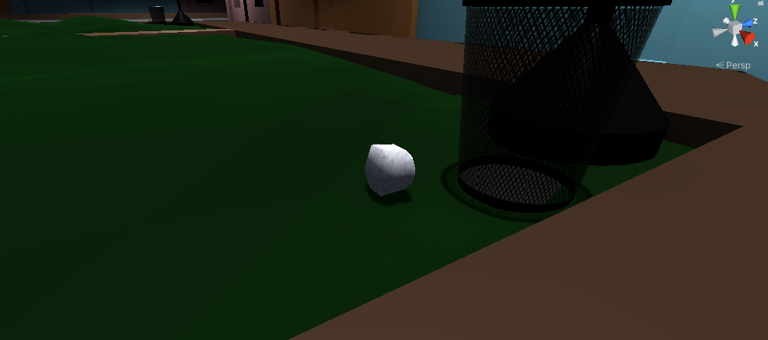
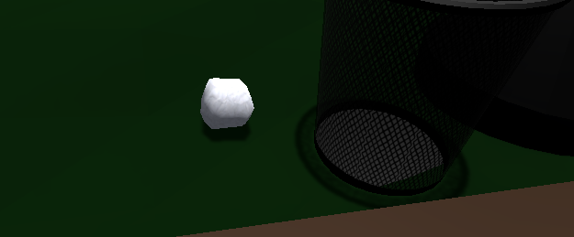
Issue 5: Paper Object Looks Like a Rock
Before:
After:
Priority: 5
Description: Paper object is too gray and looks like a rock
Evidence: Players passed over the paper object more frequently and often said “Oh, I can pick that up? I thought it was a rock.”
Action Items: Make object white to look more like paper

Slide 12
Lessons Learned

Slide 13

What Went Well:
Successful First Person Player Controller
Satisfying Pickup and Throw Mechanics
Interesting Environment (Despite lack of artists)
Effective Tutorial
Informational UI
Smart Enemy Pathfinding
Notes:
(John)

Slide 14




What To Do Differently Next Time:
More Clear way to define and organize tasks (Trello)
Add more depth to gameplay
More consistent communication
Continue to familiarize ourselves with the software
Notes:
(Zach)

Slide 15

Most Valuable Lesson Learned:
Communication is KEY!
Stay organized to avoid merge conflicts
Keep each other updated to know when new tasks are available
Communication facilitates creativity
Notes:
(Collin)

Slide 16

How We Will Develop Differently in the Future:
Possibly use a task organization tool like Trello
Strive for a higher goal
Be more aware of surprisingly difficult tasks:
UI & Menus
AI Behavior
Dealing with Unity’s Physics Engine
Managing Playtesting Feedback
Notes:
(Lucas)

Slide 17
Questions?

